Slide 1
Immigration Law County of Sonoma Commission on Human Rights September 25, 2019
Liliana Gallelli, Attorney at Law
Board Member, My American Dreams and Associate, Kerosky Purves & Bogue
Santa Rosa, CA
Notes:
----- Meeting Notes (5/22/14 00:27) -----
Joke
Estoy aca para ayudarles
Explicar las leyes
Y las excepciones que existen en las leyes
Hay veces que uno se siente desqualificado de una ley pero muchas veces si puede calificar

Slide 2
Asylum in the Trump Administration
Who is seeking asylum at the US-Mexican border?
Changes under the current administration
Process for seeking asylum at the border

Slide 3
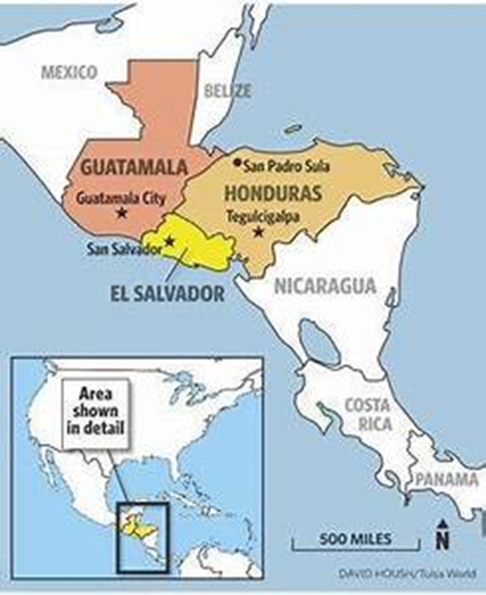
Central American Migrants

Slide 4
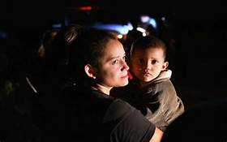
Fleeing for Their Lives
The latest data suggests that recent measures to crack down on illegal immigration have not deterred migrants, many of whom make the arduous journey over land from Central America to escape gangs and drug cartels, and domestic violence

Slide 5
A HUMANITARIAN APPROACH
In 2014, the Obama administration faced a humanitarian crisis at the border when tens of thousands of unaccompanied minors and families with children came to the US-Mexican border seeking asylum.
Congress responded by approving new resources, including additional money to house the children, and a $750 million aid package to Guatemala, El Salvador and Honduras

Slide 6
UNPRECEDENTED POLICIES IN THE CURRENT ADMINISTRATION
Trump Administration has responded by:
Threatening to cut off foreign aid to nations
Sending more U.S. soldiers to the border
Criminally prosecuting persons seeking entry into the US
Family Separation
Accelerating the process and placing quotas on Immigration Judges
Migrant Protection Protocol
Expansion of Expedited Removal

Slide 7
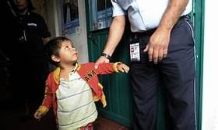
Zero Tolerance and Family Separation
Though there was no change in our laws, the Trump Administration called for a “zero tolerance” policy to criminally prosecute persons entering the country illegally. Children were not allowed to stay in detention with their parents.
Despite the effort, conditions in the Northern Triangle and Mexico outweigh the fear of the US asylum process.
Notes:
ore than 2,500 children were separated from their parents after the administration adopted a "zero-tolerance" policy to criminally prosecute every adult who enters the country illegally. Hundreds of parents were deported without their children.
The administration scrapped the policy, but is considering new options to create deterrents for immigrant families.
The government is unable to hold children generally past 20 days under court-mandated guidelines on the care of children in government custody. But administration officials are working to amend the guidelines to allow for longer detentions.
Another possibility officials were considering is to give parents a choice between being detained months or years with their children while pursuing asylum or releasing their children to a government shelter while a relative or guardian seeks custody, administration officials said.
Immigrant ad

Slide 8
MIGRANT PROTECTION PROTOCOL “Remain in Mexico”
Trump administration has required that migrants arriving at the U.S. southern border from Central American countries must first apply for asylum in another country before requesting protection in the U.S.
More than 20,000 migrants have been returned to Mexico so far this year under the program, according to Mexico’s Interior Ministry.
The policy, which was implemented on July 16, is allowed to be practiced while immigrant rights groups challenge the policy in court.

Slide 9
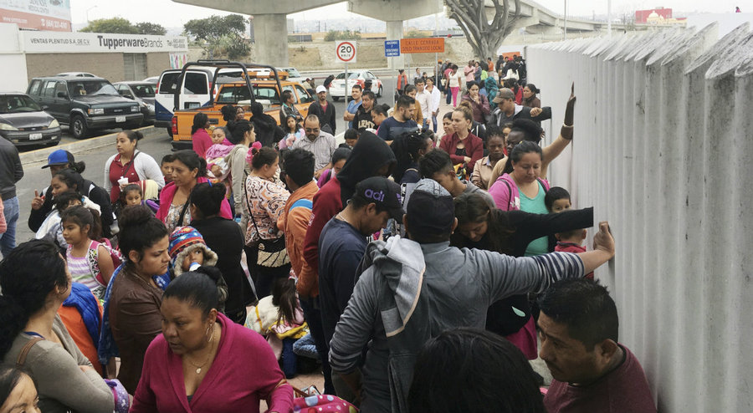
Seeking Asylum at the Border
Arrive at land border (wait)
Preliminary interview with CBP
Detention (possible criminal prosecution in addition)
Credible Fear Interview (80,000 found credible in FY 2017)
Bond Hearing or Release on Own Recognizance
Deportation Proceedings

Slide 10
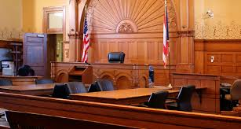
DEPORTATION PROCESS
Attend preliminary hearing
Find legal representation
Attend all scheduled hearings and submit the asylum application
Individual hearing: evidence and testimony in support of claim. An adversarial hearing where immigrant has the burden of proof. DHS opposes the immigrant’s eligibility. Immigration Judge presides
Currently Immigration Judges must complete case within 1 year.

Slide 12
Time for questions.

