Slide 1
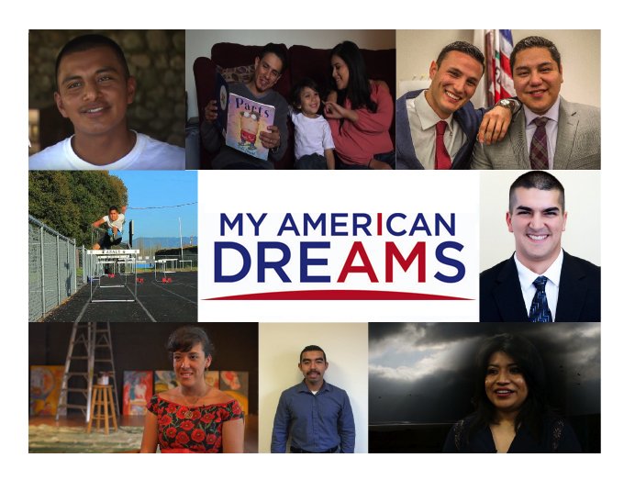
What You Need to Know about Immigrants and Immigration 7 Common Myths
Notes:
NOTES:
INTRO

Slide 2
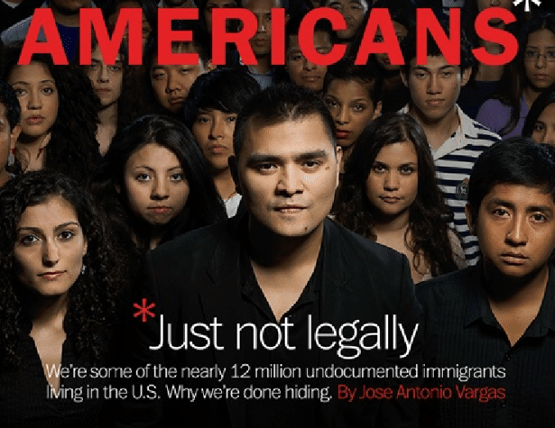
Re-Defining Immigrants
This presentation is intended to address certain myths that are prevalent in our society about immigrants and immigration.
Notes:
CHRISTOPHER:
Before we show the film, we’d like to put it in context by sharing with you some information about immigrants and immigration.
The fact is that the movement to deport millions of immigrants including those with DACA is supported by various myths or “alternative facts” . Many of these are repeated and promoted by our own federal government.

Slide 3
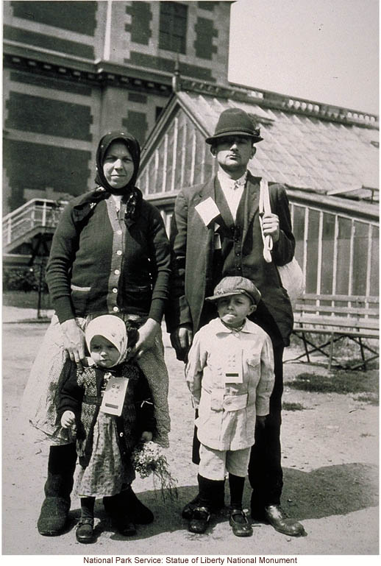
MYTH #1: Undocumented Immigrants could come the legal way, but choose to be here illegally.
Why do individuals immigrate as undocumented immigrants instead of through the system?
Notes:
CHRISTOPHER:
MYTH #2: Undocumented Immigrants could come the legal way, but choose to be here illegally
Why do individuals immigrate as undocumented immigrants when they could immigrate easily through the system?
This myth could not be more wrong. As President Obama and many other national leaders from both parties have said, our immigration system is broken:
Here's why:

Slide 4
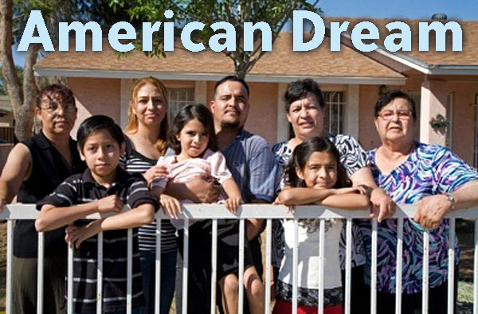
Sponsorship through family?
Family-based immigration from most countries has absurd waiting times.
Sibling petition filed today would involve a wait of 20 years for a Mexican citizen. If a US citizen parent wants to sponsor his adult son or daughter from Mexico, the wait is over 20 years.
A Mexican filing today for a green card through his parent can expect to immigrate in 2040. A sibling who files in 2017 can expect to immigrate in 2037.

Slide 5
Sponsorship through work?
Employment-based immigration. Our laws provide no practical system for petitioning immigrant workers, either skilled or unskilled, from any country.

Slide 6
Hi-tech brain drain
It’s even difficult for people with advanced degrees and high paying jobs in Silicon Valley.
For the last 5 years, all of the H1b professional visas were used up on the first day of the application season. A lottery has to be held to choose which 1 out of 3 envelopes will be opened.
This means even Google can count on only one-third of their applicants to be considered.
Notes:
Almost 200,000 people applied for the H1b professional visa on the first day of the eligibility this year (April 1 2017) – they had a lottery to see whose envelopes would be open as there are only 65,000 visas for the year.
Even huge companies like Apple and Google must expect that only 33% of their hires will get visas.

Slide 7
Bias against Mexico?
Immigration rules based on regional basis favor immigrants from Europe and other developed countries.

Slide 8
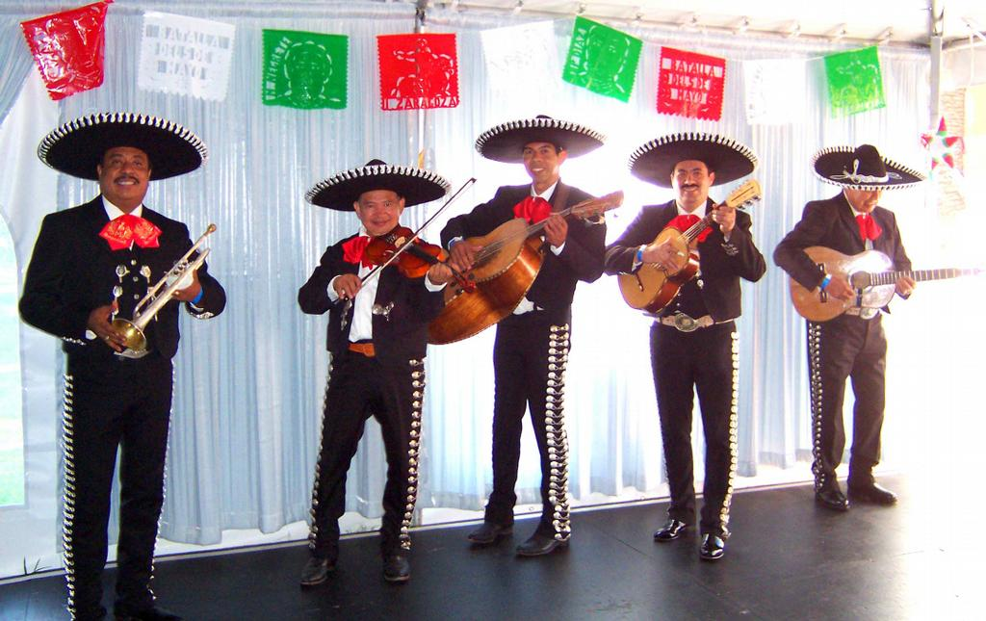
Fair?
A European who comes as an adult on his own volition and spends 10 years here illegally working and living can marry and get a green card in 4-6 months.
A Mexican who came as an infant with his parents and spent his whole life here who marries a US citizen must seek a discretionary waiver and must leave the country?
How fair is that?

Slide 9
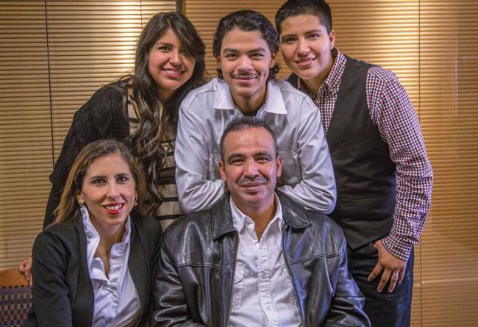
The Permanent (Mexican) Bar
1997 law punishes Mexicans who returned home for a visit. They are permanently barred from permanent residence.

Slide 10
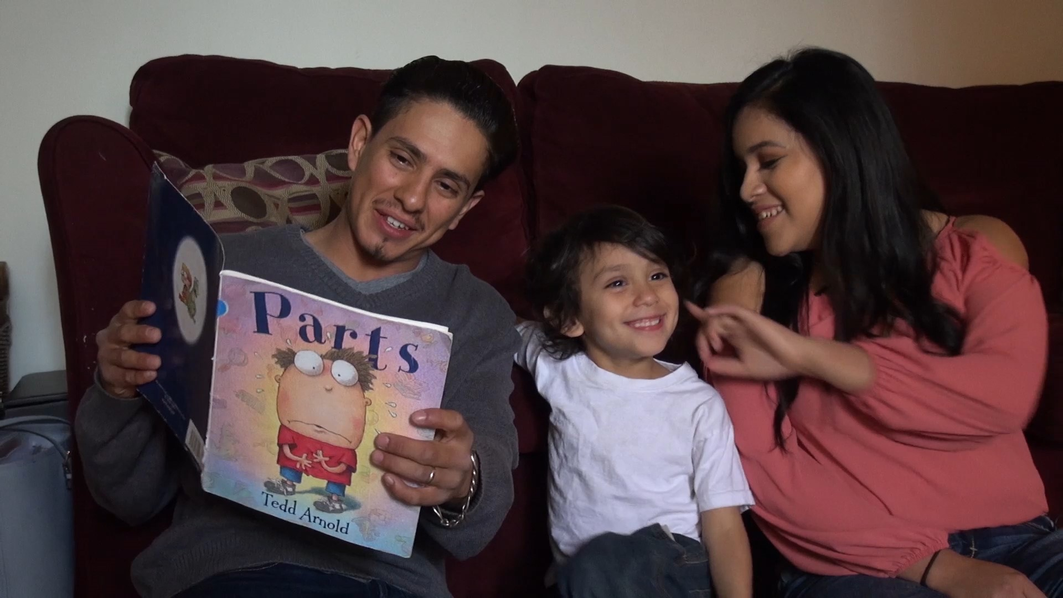
Bottom line
Bottom line for Mexican immigrants here:
Essentially there is no way to immigrate legally for the overwhelming majority of them.
And this is true for their relatives in Mexico

Slide 11
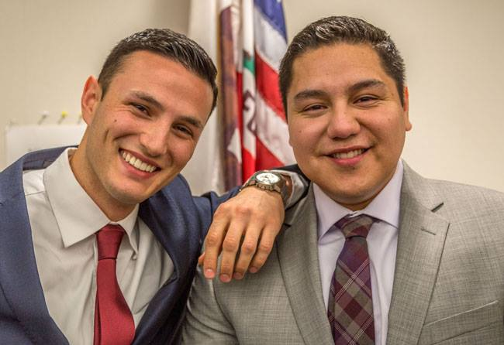
Immigration Fairness
The absurd waiting periods for legal immigration from Mexico and the inherent anti-Mexican bias in the system are always ignored by the anti-immigrant lobby.
We need to reform the visa system to allow for more sensible and equitable visa limits (and further tighten the borders) and then we could solve the illegal immigration problem.

Slide 12
MYTH #2. Our borders are porous and immigrants virtually enter the U.S. at will.
Many anti-immigrant politicians continuously repeat the false assertion that the U.S.-Mexican border is porous.
Not true.
The majority of the people trying to cross are now caught and subject to expedited deportation.
And many more here have been deported over the last Obama years than ever before.
Notes:
MYTH #1. Our borders are porous and immigrants virtually enter the U.S. at will.
Many anti-immigrant politicians continuously repeat the false assertion that the U.S.-Mexican border is porous.
Not true.
The majority of the people trying to cross are now caught and subject to expedited deportation.
And many more here have been deported over the last Obama years than ever before.

Slide 13
INVASION FROM MEXICO? Actually a Net Drop in immigration
We had far fewer immigrants enter the U.S. illegally
There is even a net drop in undocumented immigration from Mexico;
Notes:
We had far fewer immigrants enter the U.S. illegally under President Obama’s term than under President Reagan or either President Bush.
• There is even a net drop in undocumented immigration from Mexico; in other words, more Mexicans are returning to Mexico than those coming here.
Since 2009, when President Obama took office, more than one million Mexican immigrants left the U.S. for Mexico. With fewer Mexican immigrants arriving, the result has been a net loss of Mexican immigrants in the U.S.

Slide 14
UNDOCUMENTED IMMIGRATION 40% are visa overstays
Also, it’s important to note that, of the immigrants in the U.S. illegally, 40% overstayed temporary (nonimmigrant) visas. Almost all of these are from countries other than Mexico.
Notes:
Also, it’s important to note that, of the immigrants in the U.S. illegally, 40% overstayed temporary (nonimmigrant) visas. Almost all of these are from countries other than Mexico.
An increasing number of the illegal immigration coming across the Mexican border is not from Mexico; last year 15,000 immigrants from countries outside of Latin America were caught crossing the border last year – 5 times more than the previous year.

Slide 15
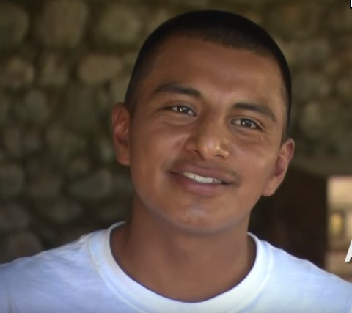
MYTH #3: Immigrants receive a lot of public benefits and therefore are a huge drain on our society’s resources
Many people wrongly believe that immigrants are a drain on our society, taking more than they give.
Actually, the opposite is true:
Notes:
MYTH #3: Immigrants receive a lot of public benefits and therefore are a huge drain on our society’s resources
Many people wrongly believe that immigrants are a drain on our society, taking more than they give.
Actually, the opposite is true:
Due to welfare reform passed in the 1990s, undocumented immigrants are severely restricted from accessing public benefits. They do not qualify for welfare, food stamps, Obamacare and virtually any other form of government assistance.
To immigrate into the US, you must have a sponsor who will testify, and provide proof, that he or she has enough money to support you, if you are unable to support yourself, or if you lose your job. This means that even if somehow you do obtain benefits, the government can seek reimbursement of those amounts from your sponsor.

Slide 16
Family and Work
Generally speaking, immigrants come to work and to reunite with family members.
Immigrant labor-force participation is consistently higher than native-born, and immigrant workers make up a larger share of the U.S. labor force than they do the U.S. population.

Slide 17
NO ENTITLEMENT
Moreover, the ratio between immigrant use of public benefits and the amount of taxes they pay is consistently favorable to the U.S.
One study estimates that immigrants earn nearly $240 billion a year. Studies find that immigrant tax payments total $20 to $85 billion more than the amount of government services they use.

Slide 18
MYTH #4: Undocumented immigrants do not pay taxes.
There is a common myth in our society that undocumented immigrants do not pay their fair share of taxes;
In fact, they give much more in taxes than they take in government assistance.
Notes:
MYTH #4: Undocumented immigrants do not pay taxes
There is a common myth in our society that undocumented immigrants do not pay their fair share of taxes;
In fact, they give much more in taxes than they take in government assistance.
Moreover, the ratio between immigrant use of public benefits and the amount of taxes they pay is consistently favorable to the U.S..
One study estimates that immigrants earn nearly $240 billion a year. Studies find that immigrant tax payments total $20 to $85 billion more than the amount of government services they use.

Slide 19
Paying in for others
Undocumented immigrants pay these taxes despite the fact that they are not eligible for taxpayer-funded programs such as Social Security, Medicare, Obama-care, welfare, and food stamps.
Notes:
Undocumented immigrants pay these taxes despite the fact that they are not eligible for taxpayer-funded programs such as Social Security, Medicare, Obama-care, welfare, and food stamps.
Undocumented immigrants cannot benefit from Social Security taxes withheld from wages.
So, the Social Security Administration has a surplus account for taxes collected largely from undocumented workers that holds an estimated $20 billion.

Slide 20
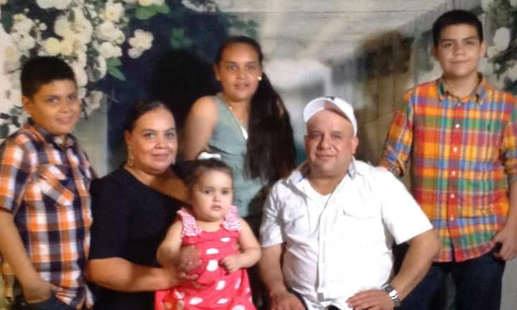
MYTH #5: Undocumented immigrants are more responsible for crime than documented persons.
Politicians frequently exploit Americans’ fears by suggesting that immigrants are making our society less safe.
In fact, the opposite is true. Here’s some facts:
Notes:
MYTH #5: Undocumented immigrants are more responsible for crime than documented persons.
Politicians frequently exploit Americans’ fears by suggesting that immigrants are making our society less safe.
They have labelled undocumented Mexican immigrants as rapists and drug dealers.
They contend that immigrants are more likely to commit crimes than those of us born here.
In fact, the opposite is true.
Here’s some facts:Research has found that immigrants are much less likely to be incarcerated than persons born here.
Roughly 1.6 % of immigrant males between ages 18 and 39 wind up in jails or prisons, less than one-half the rate for U.S.-born Americans the same age. (3.3 % for native-born American men of the same age).
Among U.S.-born men without a high school diploma, about 11 percent are incarcerated. Among similarly educated Mexican, Guatemalan and Salvadoran men here, only 2 or 3 percent get incarcerated.

Slide 21
Better than average hombre
Research has found that immigrants are much less likely to be incarcerated than persons born here.
Roughly 1.6 % of immigrant males between ages 18 and 39 wind up in jails or prisons, less than one-half the rate for U.S.-born Americans the same age. (3.3 % for native-born American men of the same age).
Among U.S.-born men without a high school diploma, about 11 percent are incarcerated. Among similarly educated Mexican, Guatemalan and Salvadoran men here, only 2 or 3 percent get incarcerated.

Slide 22
Crime drops as immigration increases
Between 1994 and 2005, violent crime rates decreased as the concentration of immigrants increased. Numerous studies have shown that a big share of the drop in crime rates in the 1990s is a result of the surge in immigration.
According to FBI statistics, despite the increased presence of undocumented immigrants, crime rates have actually dropped, while the population has increased. Only 8% of the prison population are immigrants.

Slide 23
MYTH #6: Immigration and immigration reform hurts our economy.
Some political leaders contend immigration is damaging our economy and immigration reform would make it worse; the facts say otherwise:
Notes:
MYTH #6: Immigration and Immigration Reform hurts our economy.
Some political leaders contend immigration is damaging our economy and immigration reform would make it worse; the facts say otherwise:
A Congressional Budget Office study, among others, confirms that there is much to gain economically from enabling the undocumented population to work lawfully.
The last proposed immigration reform bill (S.744 passed by the Senate in 2013) would have increased our gross national product significantly (3.3 % in 2023 and by 5.4% in 2033, according to CBO’s estimates

Slide 24
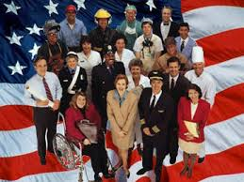
IMMIGRATION REFORM U.S. born citizens benefit too
And not only immigrants would see wage gains: reform will increase the incomes of all Americans by an estimated $124 billion. The growth in economic activity will also create an average of 28,814 jobs per year over the next 10 years for all Americans.
Immigration Reform would increase the wages of U.S.-born workers. U.S.-born workers see between a 0.1 and 0.6 percent boost in wages on average with an increase in immigration.
Notes:
And not only immigrants would see wage gains: reform will increase the incomes of all Americans by an estimated $124 billion. The growth in economic activity will also create an average of 28,814 jobs per year over the next 10 years for all Americans.
Immigration Reform would increase the wages of U.S.-born workers. U.S.-born workers see between a 0.1 and 0.6 percent boost in wages on average with an increase in immigration.

Slide 25
Good for GNP
A Congressional Budget Office study, among others, confirms that there is much to gain economically from enabling the undocumented population to work lawfully. The last proposed immigration reform bill (S.744 passed by the Senate in 2013) would have increased our gross national product significantly (3.3 % in 2023 and by 5.4% in 2033, according to CBO’s estimates
If undocumented immigrants could legalize, they would earn higher wages—an estimated total of $103 billion more over the next decade—the U.S. gross domestic product, or GDP, will increase cumulatively by $230 billion over the next 10 years.

Slide 26
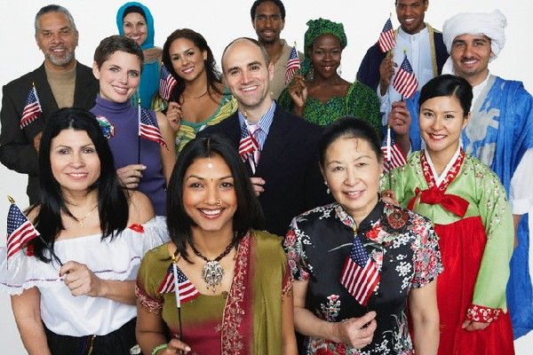
MYTH #7: Present-day immigrants are uneducated and do not assimilate to our society, unlike prior immigrants, and therefore they threaten our “American way of life”.
This is the heart of the anti-immigrant ethos: a vague and unsubstantiated suggestion that current immigrants are different from our ancestors (who all immigrated here).
It’s based on a mix of misunderstandings and prejudices that need to be exposed as false and un-American.
Here are some facts:
Notes:
MYTH #7: Present-day immigrants are uneducated and do not assimilate to our society, unlike prior immigrants, and therefore they threaten our “American way of life”.
This is the heart of the anti-immigrant ethos:
a vague and unsubstantiated suggestion that current immigrants are different from our ancestors (who all immigrated here).
It’s based on a mix of misunderstandings and prejudices that need to be exposed as false and un-American.
Here are some facts:

Slide 27
HABLA INGLES
Within ten years of arrival, more than 75% of immigrants speak English reasonably well.
Greater than 33% of immigrants are naturalized citizens; The number of immigrants naturalizing spiked sharply after two events: enactment of immigration and welfare reform laws in 1996, and the terrorist attacks in 2001.
Notes:
Within ten years of arrival, more than 75% of immigrants speak English reasonably well.
Greater than 33% of immigrants are naturalized citizens; The number of immigrants naturalizing spiked sharply after two events: enactment of immigration and welfare reform laws in 1996, and the terrorist attacks in 2001.

Slide 28
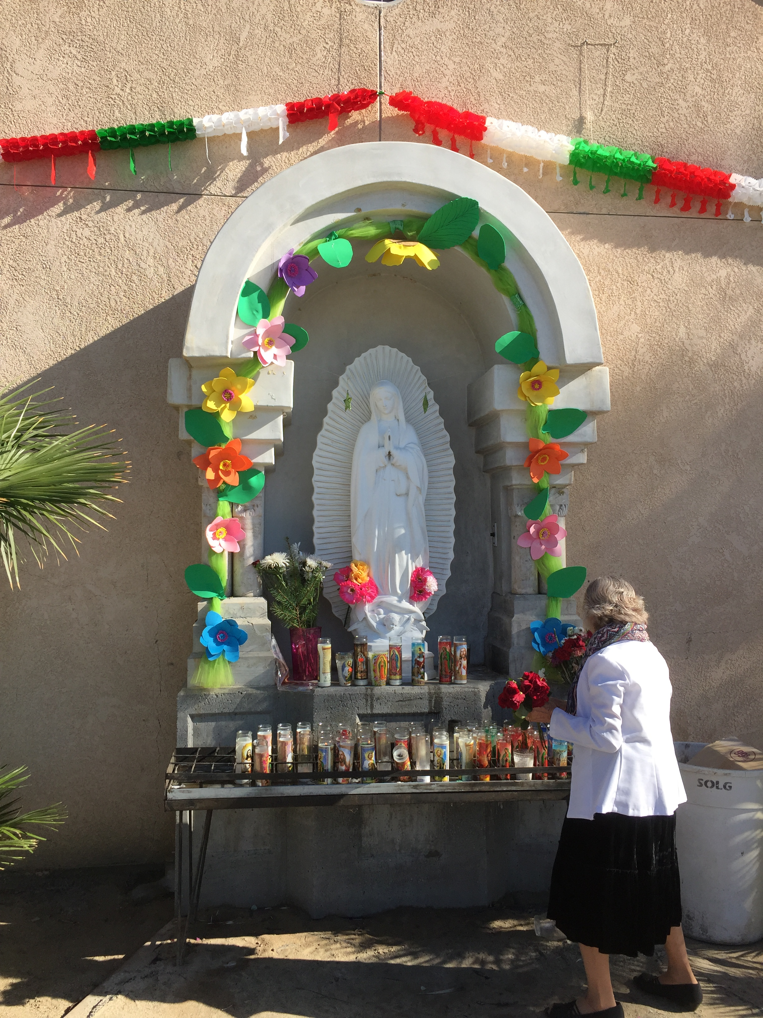
Gracias a Dios
Generally speaking, immigrants to the United States are religious, family-oriented, entrepreneurial and no more prone to crime than natives.
Seventy percent of Hispanics who moved to the U.S. in the last two decades are Catholic (one fifth are “born again” Christians) and 23 percent are Protestant.
Notes:
Generally speaking, immigrants to the United States are religious, family-oriented, entrepreneurial and no more prone to crime than natives.
Seventy percent of Hispanics who moved to the U.S. in the last two decades are Catholic (one fifth are “born again” Christians) and 23 percent are Protestant.

Slide 29
Family comes first
Immigrants are family-oriented.
One in two undocumented households has couples with children;
only 13% of them are headed by single parents—as opposed to 33%of native households.
Notes:
Immigrants are family-oriented.
One in two undocumented households has couples with children;
only 13% of them are headed by single parents—as opposed to 33%of native households.

Slide 30
Graduates
Compared with immigrants who arrived before 2000, recent immigrant arrivals are more educated. Over 75% of immigrants who have arrived after 2010 have a high school diploma or bachelor’s degree.
The percentage of immigrants without a H.S. degree has dropped by a third since 2000.
Notes:
Compared with immigrants who arrived before 2000, recent immigrant arrivals are more educated. Over 75% of immigrants who have arrived after 2010 have a high school diploma or bachelor’s degree.
The percentage of immigrants without a H.S. degree has dropped by a third since 2000

Slide 31
Sources
Wall Street Journal,
Forbes Magazine
Atlantic Magazine
New York Times
American Immigration Council
Los Angeles Times
Washington Post
Pew Research Center
U.S. Department of Homeland Security
Congressional Budget Office
Center for American Progress
Brookings Institute
Institute on Taxation and Economic Policy
Public Policy Institute of California

Slide 32
An Introduction to
MY AMERICAN DREAMS
Our website http://www.myamericandreams.org/
Facebook at http://www.facebook.com/myamericandreams
Twitter @DreaAmerican
YouTube Channel at
https://www.youtube.com/channel/UCBMWAc5-NdgJTTWcz2AhlBA

Slide 33
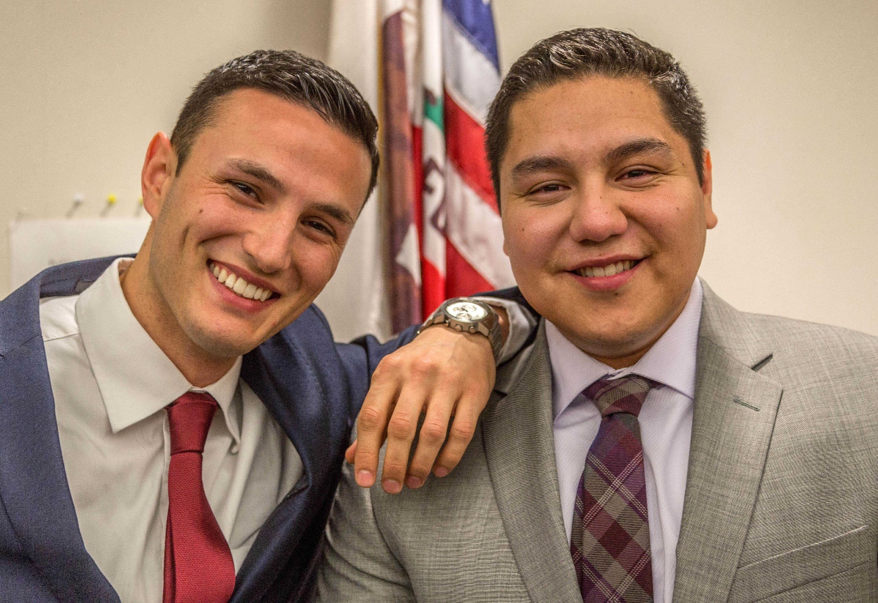
“DIEGO AND GIOVANNI”
Classmates and friends for over 20 years, Diego Jimenez and Giovanni Albertolli are both children of immigrant families, but the difference in their legal status makes a big difference in their day-to-day lives. To Watch on YouTube, go to:
https://www.youtube.com/watch?v=IF6_hBKKiw4

Slide 34
“HURDLES”
High school media students think they know their classmates, Maria Salcido and Bismark Torrez Rodriguez because they’ve been together in class and on the sports fields for years…but when participate in a film project about the Dream Act… they see them in a whole new light. To Watch on YouTube, go to: https://www.youtube.com/watch?v=yYFz2e_fCSM

Slide 35
“MARIA’S STORY”
Visual artist, Maria de Los Angeles was trained at Yale University and teaches at the Pratt Institute. In this intimate portrait, de Los Angeles explains how her art is able to be her voice in a country where she has no right to participate.
To Watch on YouTube, go to:
https://www.youtube.com/watch?v=VPJ7FxU0gck

Slide 36
“DIARY OF A DREAMER”
Denia Candela had to overcome incredible odds to pursue her education - a young mother and an undocumented immigrant, she truly had it harder than most. But thanks to the support of her community, she succeeded and thrived, while volunteering in several community organizations, Denia is about to graduate with a Bachelor’s degree in applied statistics.
To Watch on YouTube, go to:
https://www.youtube.com/watch?v=2OU5sXYcxKs

Slide 37
“ADRIAN’S STORY”
Undocumented, College, No problem! Lack of immigration status can be a tremendous barrier to obtaining a college education. Adrian describes the work ethic that enabled him to finish his college education and strive in the construction field.
To Watch on YouTube, go to:
https://www.youtube.com/watch?v=2OU5sXYcxKs

Slide 38
WHO IS BROADCASTING OUR VIDEOS? Here is a sampling of the PBS stations that have broadcasted our videos:

Slide 39
Where have our films been shown?
2014
1.20.14 Resurrection Parrish, Santa Rosa,
3.4.14 Anderson Valley High School, Boonville, Ca.
5.5.14 Cinco de Mayo Festival, Santa Rosa, Ca
9.22.14 Sonoma County Human Rights Commission, Santa Rosa, Ca.

Slide 40
Maria de los Angeles

Slide 41
Where have our films been shown?
Spring- Summer 2015
League of Women Voters and American Association of University Women, Santa Rosa
Sonoma County Human Rights Commission, Santa Rosa, Ca.
Sonoma County Public Library, Healdsburg, California.
Mendocino College, Ukiah, California.
Latinos in the Workplace Conference,

Slide 42
Diego and Gio

Slide 43
Where have our films been shown?
Fall 2015
Organizing For Action, Santa Rosa, CA.
Petaluma Public Library, Petaluma, Ca.
Sonoma County Public Library, Healdsburg, California.
Maria Carrillo High School, Santa Rosa, Ca.,
Napa County Bar Association, Napa, Ca.,

Slide 44
Adrian Reyes

Slide 45
Where have our films been shown?
Winter 2015
Sonoma County Bar Association, Santa Rosa, Ca.,
Univision, Santa Rosa, Ca
Sonoma State University, Rohnert Park, Ca.,
Santa Rosa Chamber of Commerce, Santa Rosa, Ca
Sonoma County Museum, Santa Rosa, Ca

Slide 46
Bismarck Torres

Slide 47
Where have our films been shown?
January – June 2016
Third Street Cinemas, Santa Rosa, Ca
Sonoma State University, Rohnert Park, Ca.,
Hispanic Chamber of Commerce, Santa Rosa, Ca.
Sonoma County Human Rights Commission,
Santa Rosa, Ca.

Slide 48
Denia Candela

Slide 49
Where have our films been shown?
July- December 2016
Democratic Party of Sonoma County, Penngrove, Ca., Bennett Valley Senior Center, Santa Rosa, Ca.,
C Media Public Access TV, Santa Rosa, Ca.
Alexander Valley Film Festival, Cloverdale Cinemas, Cloverdale, Ca.

Slide 50
Cristian Fertino

Slide 51
Where have our films been shown?
January – June 2017
Green Music Center, Rohnert Park, Ca.,
Performing Arts Center, Napa Valley College, Napa, Ca
Latinos in the Workplace Conference, Santa Rosa, Ca.,
Napa Chapter of American Association of University Women, Napa,

Slide 52
Victor Escobar

Slide 53
Where have our films been shown?
July- December 2017
Sonoma County Lodging Association, Santa Rosa
Mendocino Community College, Ukiah,
Analy High School, Sebastopol, Ca.
Sebastopol Center for the Arts, Sebastopol, Ca.

Slide 54
Thank you for your time
GRACIAS POR SU ATENCION Y TIEMPO

